Slide 1
Algorithms and Data Structures
      Dr Mehmet Bülent Özcan,
      (Module Leader/Lecturer/Tutor)
        Room: Cantor 9418
        Phone: extn 6900
        Email: m.b.ozcan@shu.ac.uk

Slide 2
Learning Objectives
To learn how to workout the time complexity of an algorithm
To learn Time-Space Tradeoff of an algorithm

Slide 3
Contents of the Lecture
Complexity of Algorithms
Example (Searching Algorithms)
Examples (Time-Space Trade-Off)
More on Complexity
Big O Notation
Rate of Growth
Examples

Slide 4
Complexity of Algorithms (1)
The analysis of algorithms is a major task in computer science.
In order to compare algorithms, we must have some criteria to measure the efficiency of our algorithms.
The time and space, which an algorithms uses, are two major measures of the efficiency of the algorithm.
The complexity of an algorithm is the function which gives the running time and/or space in terms of the input size.

Slide 5
Complexity of Algorithms (2)
Each of our algorithms will involve a particular data structure. Accordingly, we may not always be able to use the most efficient algorithm, since the choice of data structure depends on many things, including
  the type of data,
  the frequency with which various data operations are applied.
Sometimes the choice of data structure involves a time-space trade-off: by increasing the amount of space for storing the data, one may be able to reduce the time needed for processing the data, or vice versa.

Slide 6
Example: Searching Algorithms
Consider a membership file in which each record contains, among other data, the name and telephone number of its member. Suppose we are given the name of a member, and we want to find his or her telephone number. This section discusses two such searching algorithms. We note that the running time of a searching algorithm is usually measured by the number C(n) of comparisons where n is the number of records in the file.
    Linear search: Search each record of the file, one at a time, until finding the given Name and hence the corresponding telephone number.
    Assuming that each name in the file is equally likely to be picked, one can show that the average number of comparisons to find a record in a file with n records is approximately equal to n/2; that is, the complexity of the linear search algorithm is
    C(n) ≈ n/2

Slide 7
Example: Searching Algorithms (2)
    Binary search: Compare the given Name with the name in the middle of the list; this tells which half of the list contains Name. Then compare Name with the name in the middle of the correct half to determine which quarter of the list contains Name. Continue the process until finding Name in the list.
Here one can show that the number C(n) of comparisons of the binary search algorithm is given by
C(n) ≈ log₂n

Slide 8
Time-Space Trade-Off Examples^{[1]}
Re-rendering vs. stored images
  Storing only the SVG source of a vector image and rendering it as a bitmap image every time the page is requested would be trading time for space; more time used, but less space. Rendering the image when the page is changed and storing the rendered images would be trading space for time; more space used, but less time. This technique is more generally known as caching.
Lookup tables vs. recalculation
  A common situation is an algorithm involving a lookup table: an implementation can include the entire table, which reduces computing time, but increases the amount of memory needed, or it can compute table entries as needed, increasing computing time, but reducing memory requirements.

Slide 9
Time-Space Trade-Off Examples (2)
Database indexes vs. table scans
  Database Management Systems offer the capability to create Database index data structures. Indexes improve the speed of lookup operations at the cost of additional space. Without indexes, time-consuming Full table scan operations are sometimes required to locate desired data.
Compressed vs. uncompressed data
  A space–time trade off can be applied to the problem of data storage. If data is stored uncompressed, it takes more space, but access takes less time than if the data were stored compressed (since compressing the data reduces the amount of space it takes, but it takes time to run the decompression algorithm). Depending on the particular instance of the problem, either way is practical. There are also rare instances where it is possible to directly work with compressed data, such as in the case of compressed bitmap indices, where it is faster to work with compression than without compression.

Slide 10
Time-Space Trade-Off Examples (3)
Smaller code vs. loop unrolling
  Larger code size can be traded for higher program speed when applying loop unrolling. This technique makes the code longer for each iteration of a loop but saves the computation time required for jumping back to the beginning of the loop at the end of each iteration.

Slide 11
Time-Space Trade-Off Examples (3)
Suppose a file of records contains names, social security numbers and much additional information among its fields.
Sorting the file alphabetically and using a binary search is a very efficient way to find the record for a given name. On the other hand, suppose we are given only the social security number of the person. Then we would have to do a linear search for the record, which is extremely time-consuming for a very large number of records.
How can we solve such a problem?
    One way is to have another file which is sorted numerically according to social security number. This, however, would double the space required for storing the data.

Slide 12
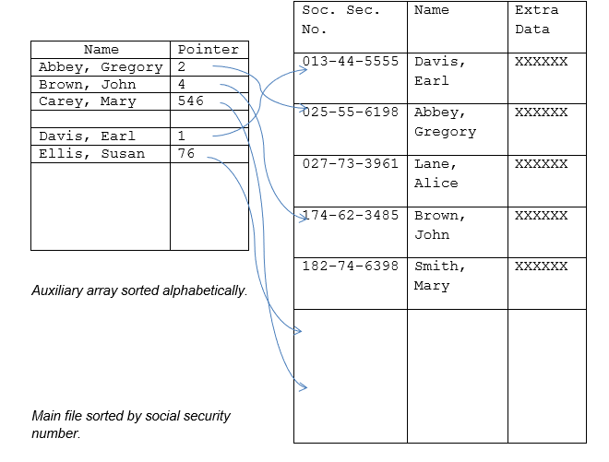
Time-Space Trade-Off Examples (4)

Slide 13
More on Complexity of Algorithms
The analysis of algorithms is a major task in computer science. As already stated, to compare algorithms, we must have some criteria to measure the efficiency of our algorithms.
Suppose M is an algorithm, and suppose n is the size of the input data. The time and space used by the algorithm M are the two main measures for the efficiency of M.
The time is measured by counting the number of key operations- in sorting and searching algorithms, for example, the number of comparisons. That is because key operations are so defined that the time for the other operations is much less than or at most proportional to the time for the key operations. The space is measured by counting the maximum of memory needed by the algorithms.

Slide 14
More on Complexity of Algorithms (2)
The complexity of an algorithm M is the function f(n) which gives the running time and/or storage space requirement of the algorithm in terms of the size n of the input data.
Frequently, the storage space required by an algorithm is simply a multiple of the data size n. Accordingly, unless otherwise stated or implied, the term "complexity" shall refer to the running time of the algorithm.

Slide 15
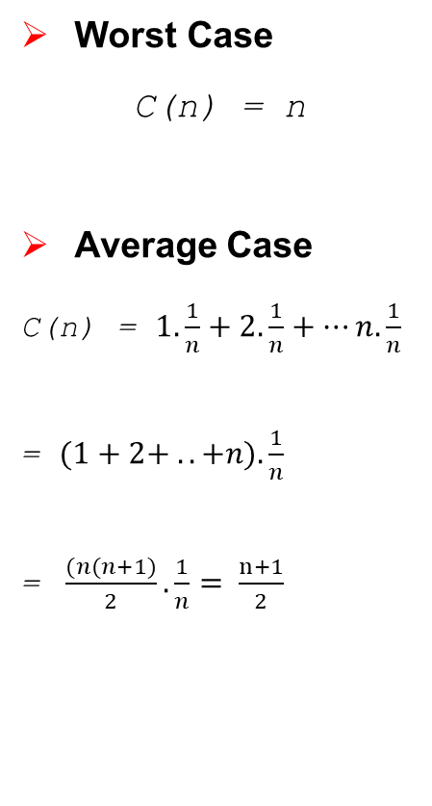
More on Complexity of Algorithms (3)
declare DATA[1..n], item, loc
index ← 1
loc ← 0
Read(item)
REPEAT
IF item = DATA(index) then loc ← index
else index ← index + 1
endif
UNTIL loc ≠ 0 or index > n
IF loc = 0 then print("Item is not in the array DATA")
else print(loc, " is the location of ITEM")
endif
Worst Case
C(n) = n
Average Case
C(n) = $1. \frac{1}{n}+2. \frac{1}{n}+…n. \frac{1}{n}$
= $(1+2+ .. +n). \frac{1}{n}$
= $\frac{(n(n+1)}{2}. \frac{1}{n}= \frac{n+1}{2}$

Slide 16
Big O Notation
Suppose f(n) and g(n) are functions defined on the positive integers with the property that f(n) is bounded by some multiple of g(n) for almost all n. That is, suppose there exist a positive integer n₀ and a positive number M such that, for all n > n₀, we have
│f(n)│ ≤ M │g(n)│
Then we may write
f(n) = O(g(n))
which is read "f(n) is of order g(n)". For any polynomial P(n) of degree m,
P(n) = O(n^{m}); e.g.,
8n³ - 576n² + 832n - 248 = O(n³)
The proof of the above is outside the scope of this module.

Slide 17
Big O Notation (2)
To indicate the convenience of this notation, we give the complexity of certain well-known searching and sorting algorithms (refer to “Big-O Cheat Sheet” on Blackboard):
  Linear search: O(n)
  Binary search: O(log₂ n)
  Bubble sort: O(n²)
  Merge sort: O(n log₂ n)

Slide 18
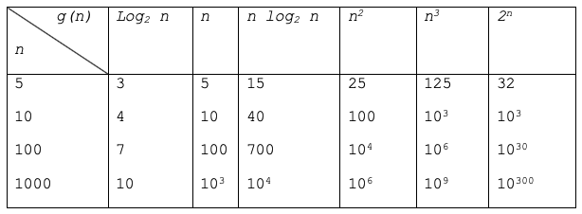
Rate of Growth
Suppose M is an algorithm, and suppose n is the size of the input data. Clearly the complexity f(n) of M increases as n increases. It is usually the rate of increase of f(n) that we want to examine. This is usually done by comparing f(n) with some standard function, such as
      log₂ n, n, n log₂ n, n², n³, 2n

Slide 19
Rate of Growth (2)
We write O(1) to mean a computing time which is a constant. O(n) is called linear, O(n²) is called quadratic, O(n³) is called cubic, and O(2^{n}) is called exponential.
If an algorithm takes time O(log n) it is faster, for sufficiently large n, than if it had taken O(n). Similarly, O(n log n) is better than O(n²) but not as good as O(n).
If we have two algorithms which perform the same task, and the first has a computing time which is O(n) and the second O(n²), then we will usually take the first as superior. The reason for this is that as n increases the time for the second algorithm will get far worse than the time for the first.

Slide 20
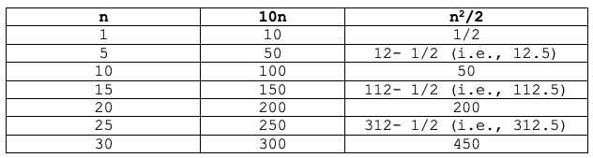
Rate of Growth (3)
For example, if the constant for algorithms one and two are 10 and ½ respectively, then we get the following table of computing times:
For example, if the constant for algorithms one and two are 10 and ½ respectively, then we get the following table of computing times:
For n ≤ 20, the algorithm two had a smaller computing time but once past that point algorithm one becomes better. This shows why we choose the algorithm with the smaller order of magnitude, but we emphasise that this is not the whole story.

Slide 21
Rate of Growth (4)
For small data sets, the respective constants must be carefully determined. In practice these constants depend on many factors, such as the language and the machine one is using. Thus, we will usually postpone the establishment of the constant until after the program has been written. Then a performance profile can be gathered using real time calculation.
For large data sets, algorithms with a complexity greater than O(n log n) are often impractical. An algorithm, which is exponential, will work only for very small inputs. For exponential algorithms, even if we improve the constant, say by ½ or 1/3, we will not improve the amount of data we can handle by very much.

